Slide 1
River Sediment Parameterization (Literature Review)
Grain Size, Hyporheic Exchange, POM Settling

Slide 2
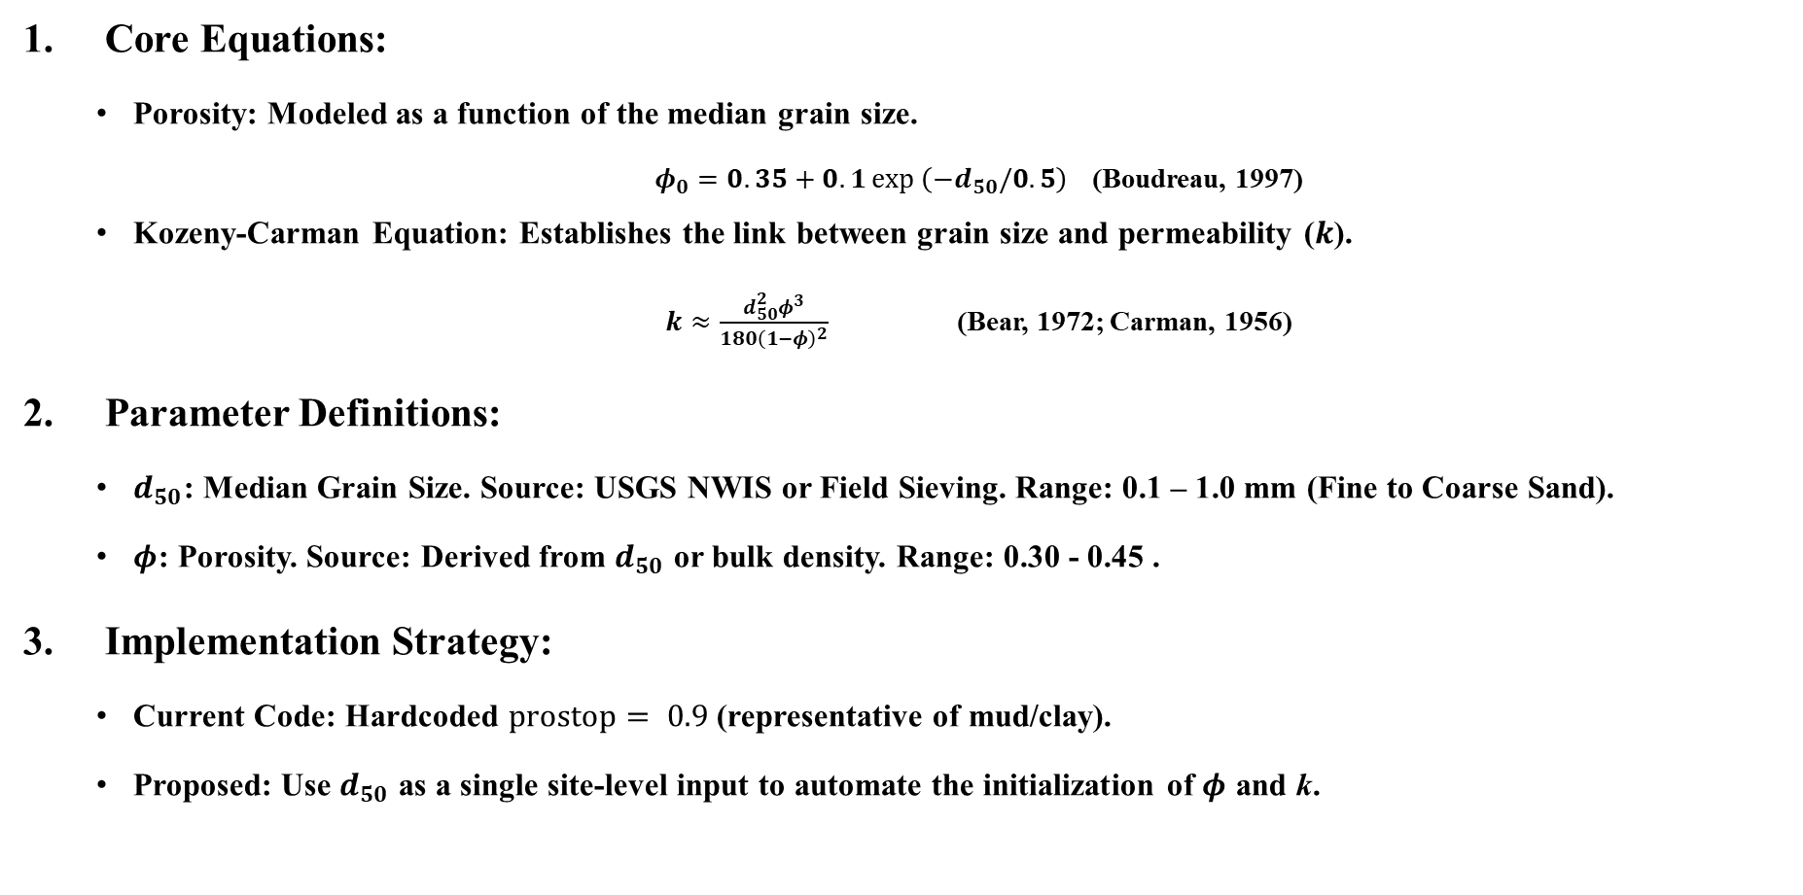
Grain Size (d₅₀) as the Master Variable
Core Equations:
Porosity: Modeled as a function of the median grain size.
$φ_{0}=0.35+0.1\exp\left(−d_{50}/0.5\right)$ (Boudreau, 1997)
Kozeny-Carman Equation: Establishes the link between grain size and permeability ($k$).
$k≈\frac{d_{50}^{2}φ^{3}}{180{\left(1−φ\right)}^{2}}$ (Bear, 1972; Carman, 1956)
Parameter Definitions:
$d_{50}$: Median Grain Size. Source: USGS NWIS or Field Sieving. Range: 0.1 – 1.0 mm (Fine to Coarse Sand).
$φ$: Porosity. Source: Derived from $d_{50}$ or bulk density. Range: 0.30 - 0.45 .
Implementation Strategy:
Current Code: Hardcoded $prostop= 0.9$ (representative of mud/clay).
Proposed: Use $d_{50}$ as a single site-level input to automate the initialization of $φ$ and k.

Slide 3
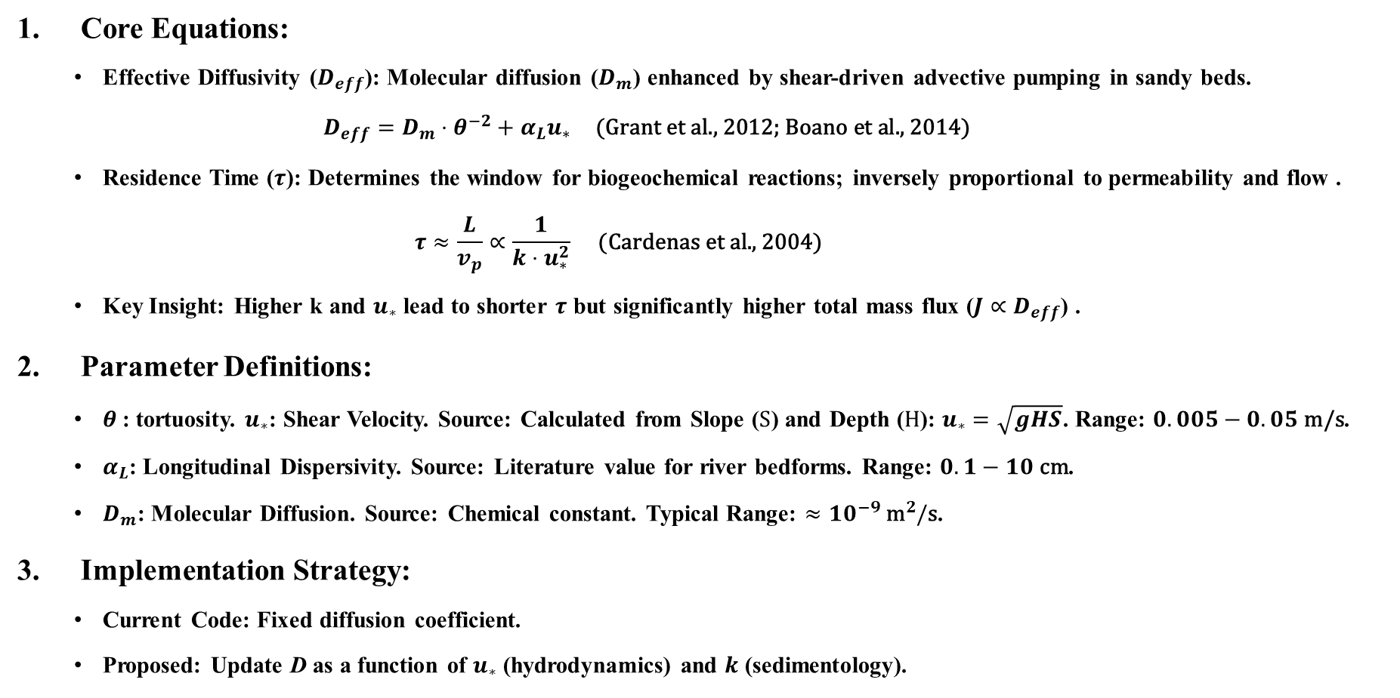
Hyporheic Zone Diffusion & Residence Time
Core Equations:
Effective Diffusivity ($D_{eff}$): Molecular diffusion ($D_{m}$) enhanced by shear-driven advective pumping in sandy beds.
$$D_{eff}=D_{m}⋅θ^{−2}+α_{L}u_{∗} \text{(}\text{Grant} \text{et} \text{al}\text{., 2012; }\text{Boano} \text{et} \text{al}\text{., 2014)}$$
Residence Time ($τ$): Determines the window for biogeochemical reactions; inversely proportional to permeability and flow .
$$τ≈\frac{L}{v_{p}}∝\frac{1}{k⋅u_{∗}^{2}} \text{(}\text{Cardenas} \text{et} \text{al}\text{., 2004)}$$
Key Insight: Higher k and $u_{∗}$ lead to shorter $τ$ but significantly higher total mass flux ($J∝D_{eff}$) .
Parameter Definitions:
$θ$: tortuosity. $u_{∗}$: Shear Velocity. Source: Calculated from Slope ($S$) and Depth ($H$): $u_{∗}=\sqrt{gHS}$. Range: $0.005−0.05 \text{m}\text{/}\text{s}$.
$α_{L}$: Longitudinal Dispersivity. Source: Literature value for river bedforms. Range: $0.1−10 \text{cm}$.
$D_{m}$: Molecular Diffusion. Source: Chemical constant. Typical Range: $≈10^{−9} {\text{m}}^{2}/\text{s}$.
Implementation Strategy:
Current Code: Fixed diffusion coefficient.
Proposed: Update D as a function of $u_{∗}$ (hydrodynamics) and $k$ (sedimentology).

Slide 4
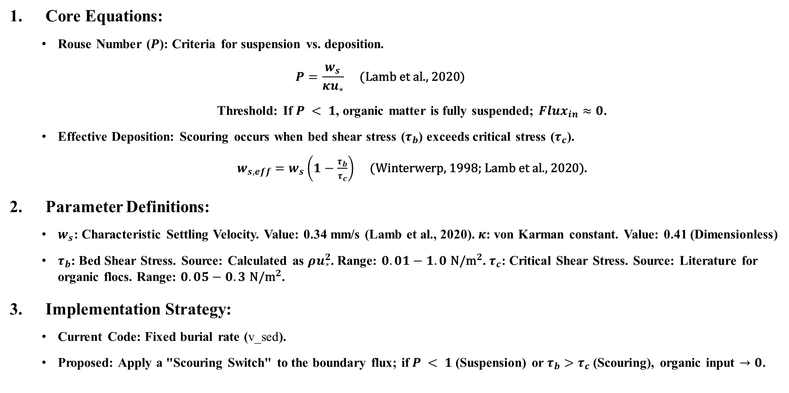
River POM Settling & Flocculation
Core Equations:
Rouse Number ($P$): Criteria for suspension vs. deposition.
$$P=\frac{w_{s}}{κu_{∗}} \text{(}\text{Lamb} \text{et} \text{al}\text{., 2020)}$$
Threshold: If $P < 1$, organic matter is fully suspended; $Flux_{in}≈0$.
Effective Deposition: Scouring occurs when bed shear stress ($τ_{b}$) exceeds critical stress ($τ_{c}$).
$w_{s,eff}=w_{s}\left(1−\frac{τ_{b}}{τ_{c}}\right) \text{(}\text{Winterwerp}\text{, 1998; }\text{Lamb} \text{et} \text{al}\text{., 2020)}$.
Parameter Definitions:
$w_{s}$: Characteristic Settling Velocity. Value: 0.34 mm/s (Lamb et al., 2020). $κ$: von Karman constant. Value: 0.41 (Dimensionless)
$τ_{b}$: Bed Shear Stress. Source: Calculated as $ρu_{∗}^{2}$. Range: $0.01−1.0 {\text{N}\text{/}\text{m}}^{2}$. $τ_{c}$: Critical Shear Stress. Source: Literature for organic flocs. Range: $0.05−0.3 {\text{N}\text{/}\text{m}}^{2}$.
Implementation Strategy:
Current Code: Fixed burial rate (v_sed).
Proposed: Apply a "Scouring Switch" to the boundary flux; if$P < 1$ (Suspension) or $τ_{b}>τ_{c}$ (Scouring), organic input $→0$.

Slide 5
Reference
Grant, S. B. et al. Effective diffusivity and mass flux across the sediment-water interface in streams. Water Resour. Res. 48, W05548 (2012) .
Boano, F. et al. Hyporheic flow and transport processes: Mechanisms, models, and ecosystems. Rev. Geophys. 52, 603–679 (2014) .
Boudreau, B. P. Diagenetic Models and Their Implementation. (Springer, 1997) .
Lamb, M. P. et al. Mud in rivers transported as flocculated and suspended bed material. Nature Geosci. 13, 566–570 (2020).
Winterwerp, J. C. A simple model for turbulence-induced flocculation of cohesive sediment. J. Hydraul. Eng. 124, 430–436 (1998).
Cardenas, M. B., Wilson, J. L. & Zlotnik, V. A. Impact of river bedform-induced hyporheic flow on long-term residence time distributions. Water Resour. Res. 40, W08403 (2004) .
Bear, J. Dynamics of Fluids in Porous Media. (Dover Publications, 1972) .
Carman, P. C. Flow of Gases Through Porous Media. (Butterworths Scientific Publications, 1956) .

Slide 6
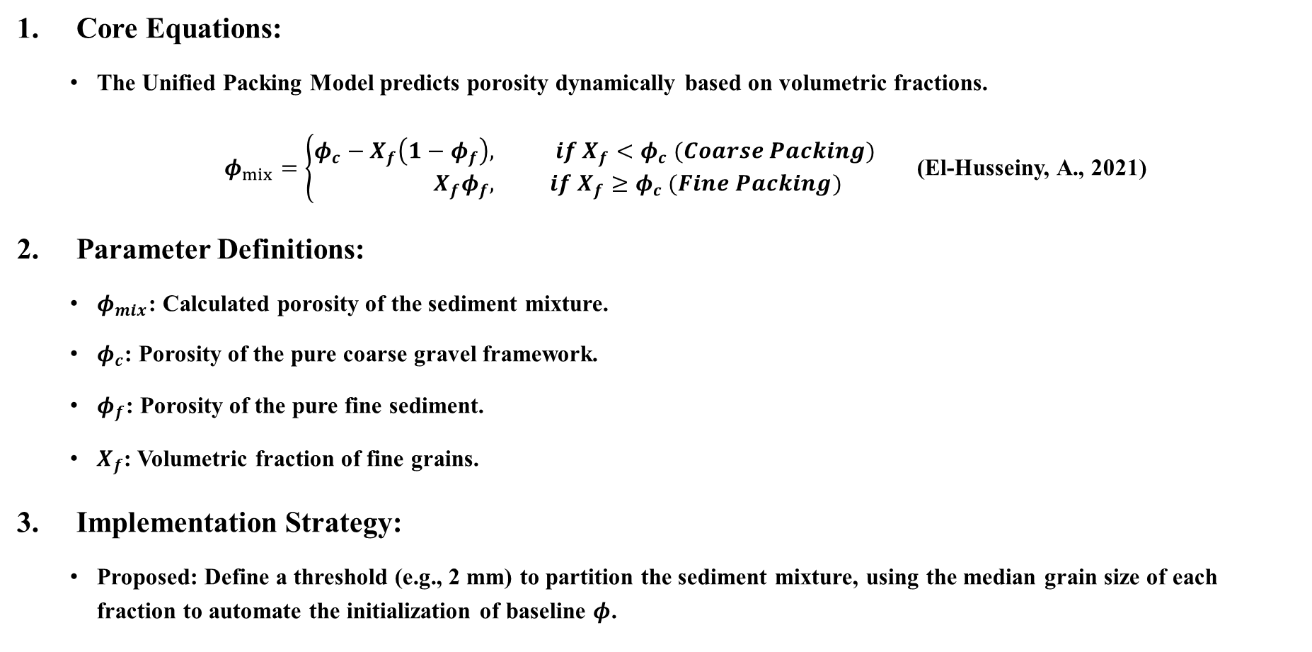
Multiple Grain Size and Porosity Modeling
Core Equations:
The Unified Packing Model predicts porosity dynamically based on volumetric fractions.
$φ_{mix}=\left\{\begin{aligned}φ_{c}−X_{f}\left(1−φ_{f}\right), & if X_{f}<φ_{c} (Coarse Packing) \\ X_{f}φ_{f}, & if X_{f}≥φ_{c} (Fine Packing)\end{aligned}\right.$ (El-Husseiny, A., 2021)
Parameter Definitions:
$φ_{mix}$: Calculated porosity of the sediment mixture.
$φ_{c}$: Porosity of the pure coarse gravel framework.
$φ_{f}$: Porosity of the pure fine sediment.
$X_{f}$: Volumetric fraction of fine grains.
Implementation Strategy:
Proposed: Define a threshold (e.g., 2 mm) to partition the sediment mixture, using the median grain size of each fraction to automate the initialization of baseline $φ$.

Slide 7
Reference
El-Husseiny, A. Unified packing model for improved prediction of porosity and hydraulic conductivity of binary mixed soils. Water 13, 455 (2021).
Uchida, T., Kawahara, Y., Hayashi, Y. & Tateishi, A. Eulerian deposition model for sediment mixture in gravel-bed rivers with broad particle size distributions. J. Hydraul. Eng. 146, 04020071 (2020).
Bui, V. H., Bui, M. D. & Rutschmann, P. Advanced numerical modeling of sediment transport in gravel-bed rivers. Water 11, 550 (2019).

Slide 8
Parameter change for river env
P = 1;
previous 500; % pressure at depth [atm]
S = 0.1;
previous 35; % salinity [ppt]
F_CaCO3 = 10;
previous 2000; %100; %10;%500; % Flux of CaCO3 to sediment gram/m2/year
SO4init = 2000;
previous 28000; % uM - SO4 concentration at SWI
k_calcite = 1E-2;
previous 1000; %umol/l/year
Calcium = 1000;
previous 10000; % calcium concentration [uM?]

Slide 9
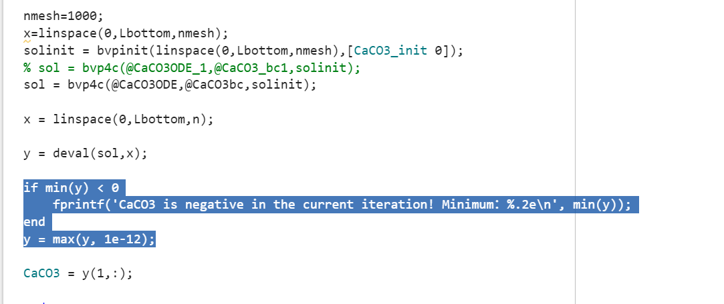
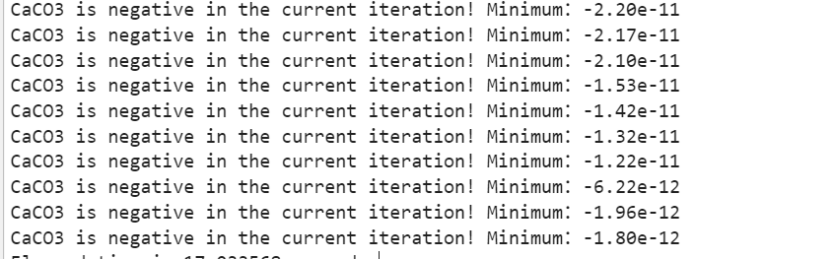
Bug and debug

Slide 10
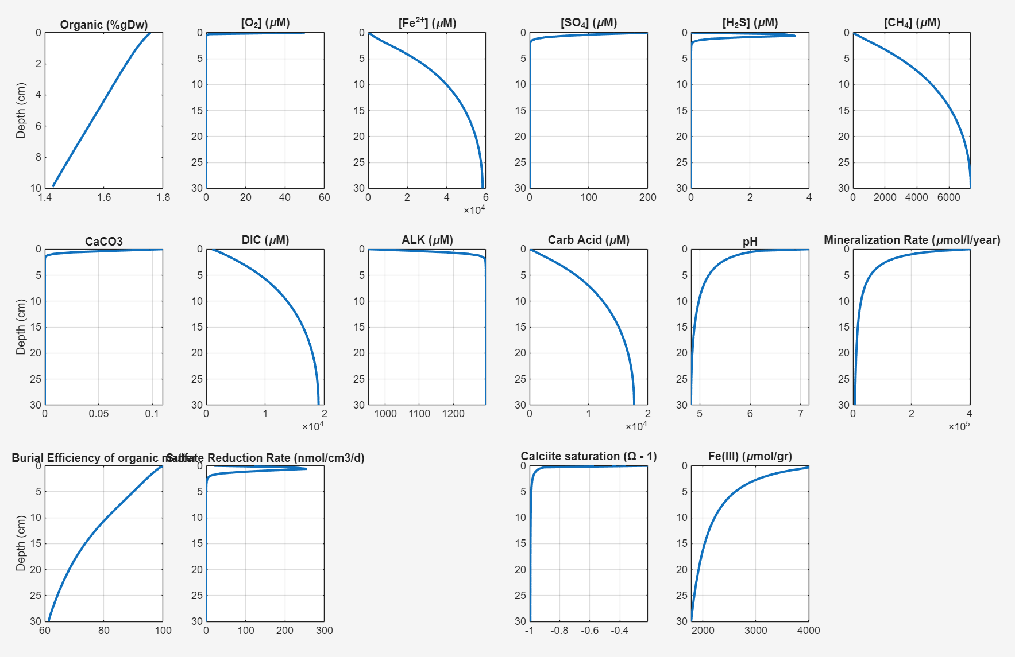
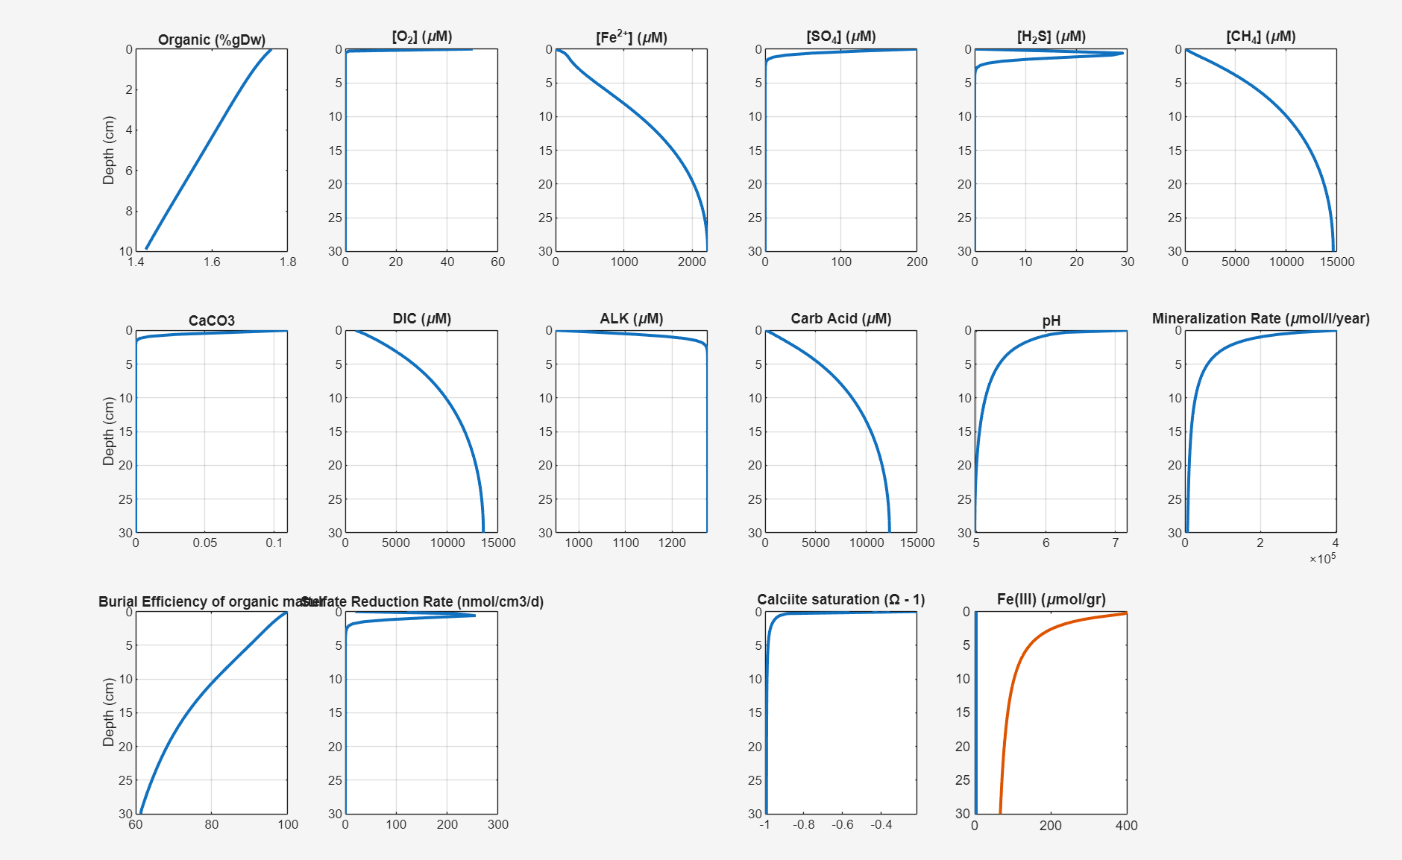
Different Scenarios under Coupled Model - Methane Hotspot
T=30;
degree C;Summer
O2init=50;
uM; Anoxic
SO4init = 200;
uM; Freshwater
NPP = 800;
g/m2/yr; High OC
Vbottom=1;
cm/yr; Backwater

Slide 11
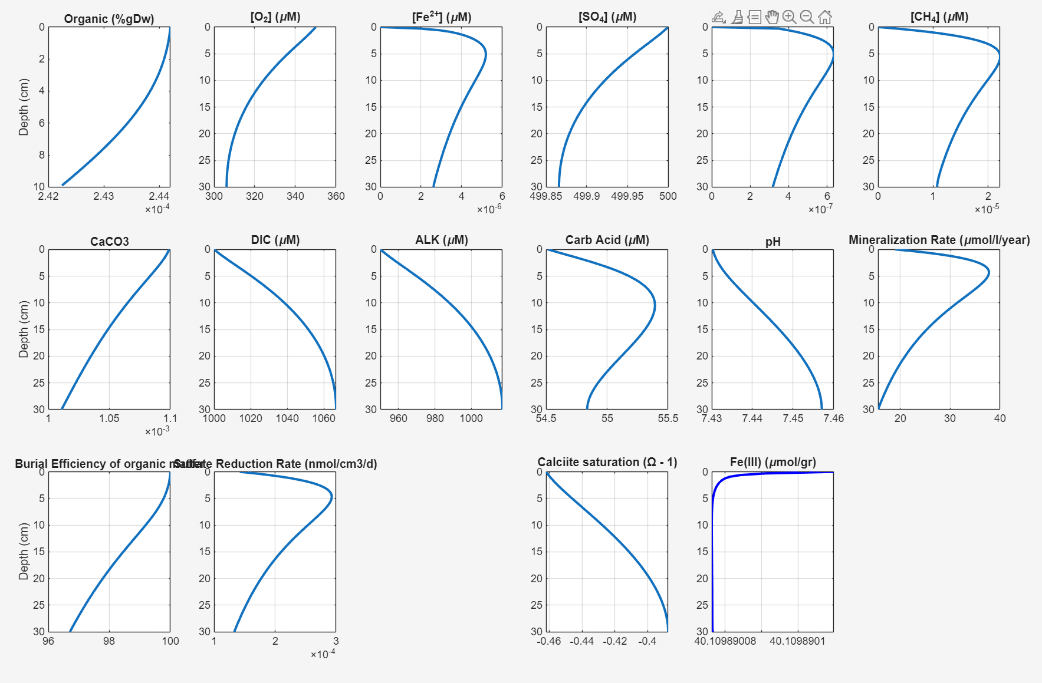
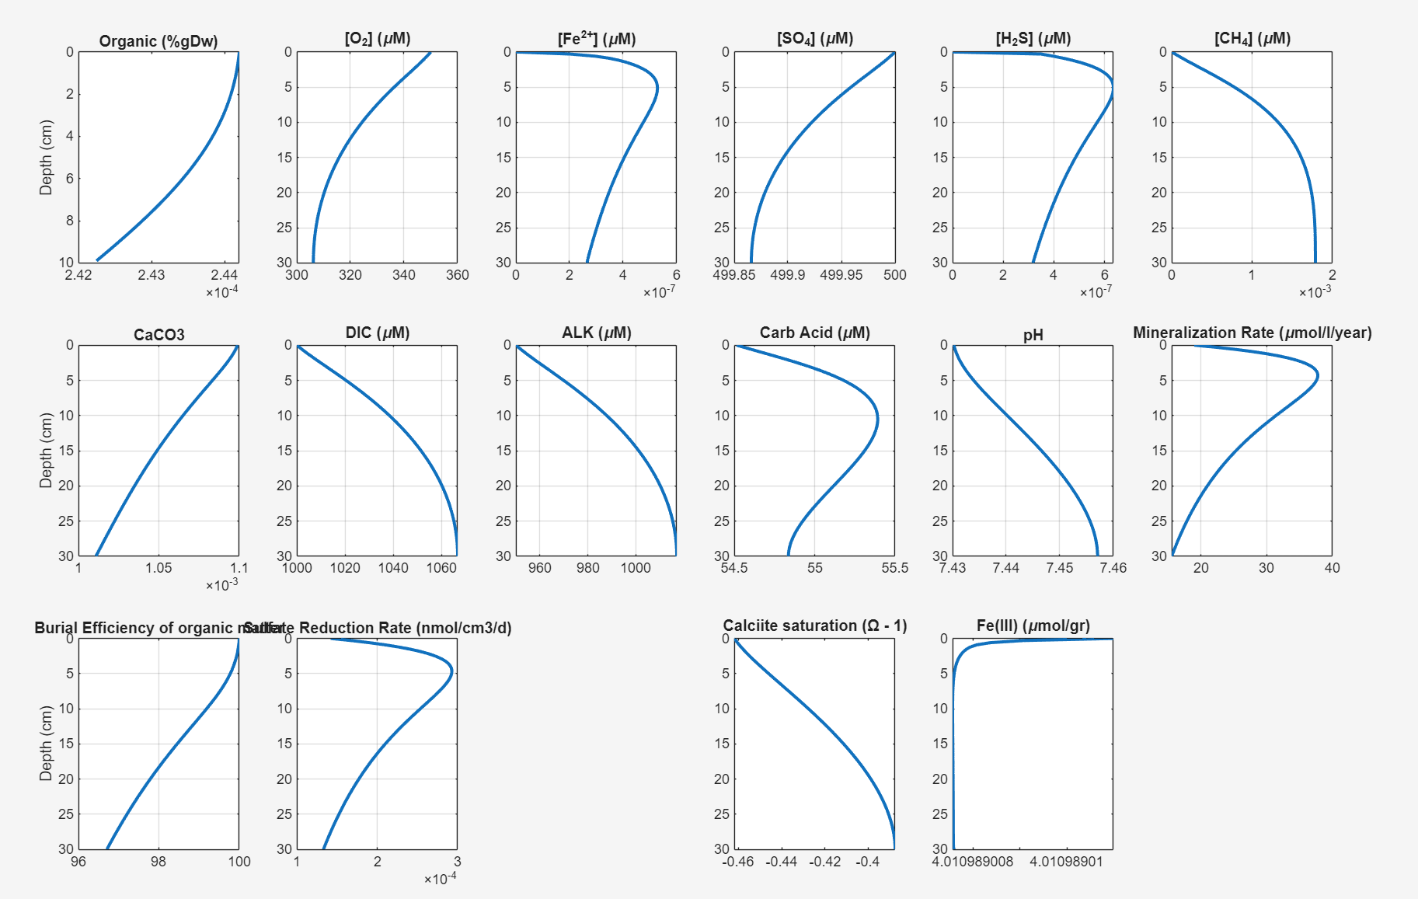
Different Scenarios under Coupled Model - Spring Mountainous
T=5;
Early Spring
O2init=350;
uM; Oxic
SO4init = 500;
uM; Medium
NPP = 10;
g/m2/yr; Low OC
Vbottom=100;
cm/yr; Turbulent

Slide 12
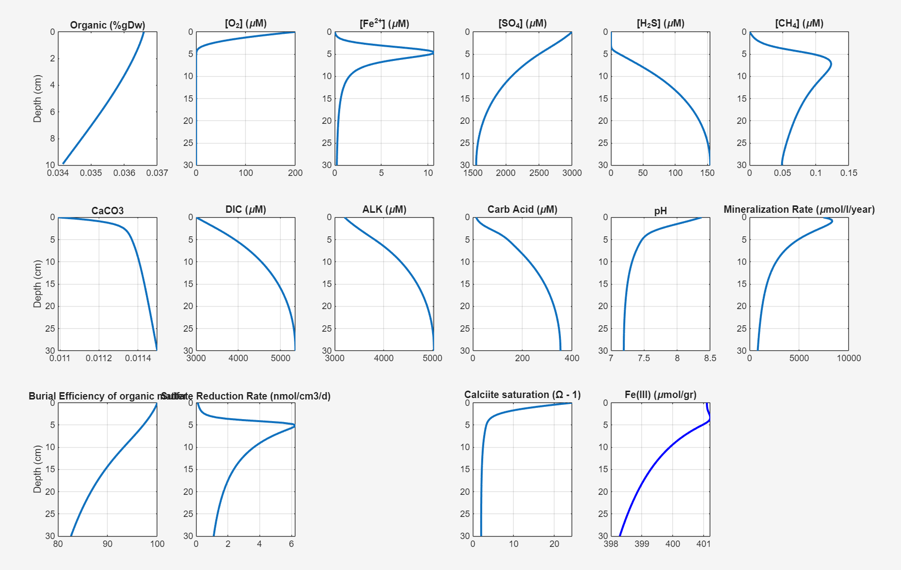
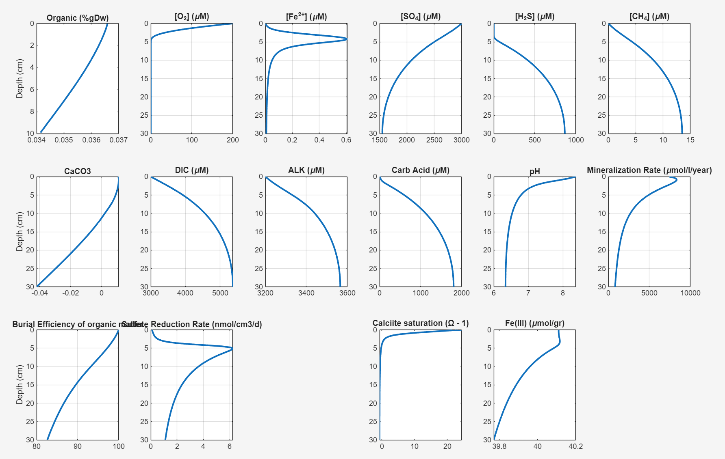
Different Scenarios under Coupled Model - Carbonate Burial
O2init=200;
uM; Normal
SO4init = 3000;
uM; High
DICinit=3000;
uM; High IC
HCO3init = 2000;
uM; High ALK
NPP = 150;
g/m2/yr; Mid OC
Vbottom=10;
cm/yr; Medium

Slide 13
Next Step -Adding Input for USGS stations
T
O2
ALK/DIC
POC conc
Grain Distribution; for Porosity
Sheer V=gHS⁻²; for POM setting rate and Hyporheic diffusion
SO4?; for CH4 proxy

